Slide 1
Lecture 4: Circuit Partitioning – II
Tsung-Wei (TW) Huang
Department of Electrical and Computer Engineering
University of Utah, Salt Lake City, UT
Notes:
Today, we are going to continue on our journey to circuit partitioning, Part II. We will discuss another very classical, famous, and widely used partitioning algorithm, FM partitioning algorithm. This is an algorithm specifically designed for partitioning hypergraph.

Slide 2
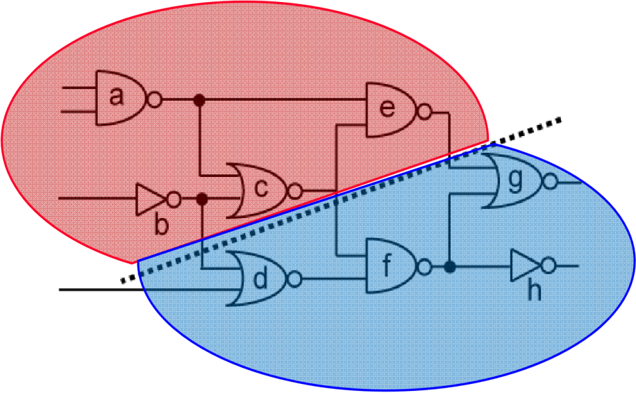
Recap: Circuit Partition
An essential step for reducing algorithm design complexity
Divide and conquer (D&C)
Input
A circuit graph
Output
A set of partitioned subgraphs
Objective
Minimize cross-connection
Balance each partition area
Notes:
Let’s refresh what we have learned so far. Last time, we have talked about circuit partition. (explain …)

Slide 3
Recap: KL Algorithm
1. Pair-wise exchange of nodes to reduce cut size
2. Allow cut size to increase temporarily within a pass
3. Compute the gain of a swap
Repeat
Perform a feasible swap of max gain
Mark swapped nodes “locked”
Update swap gains
Until no feasible swap
4. Find max prefix partial sum in gain sequence g₁, g₂, …, g_{m}
5. Make corresponding swaps permanent
6. Start another pass if current pass reduces the cut size
u •
v •
v •
u •
locked

Slide 4
Recap: Drawbacks of KL Algorithm
Handle only unit vertex weights
Vertex weights might represent block sizes, different from blocks to blocks in real situation
Handle only exact bisection
Need dummy vertices to handle the unbalanced problem
Handle only non-hypergraphs
Practical circuits have many terminal nodes for each cell output
Need to handle multi-terminal nets directly
B
A
A has two terminals, B and C!
C
D

Slide 5
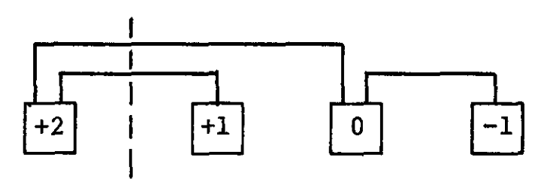
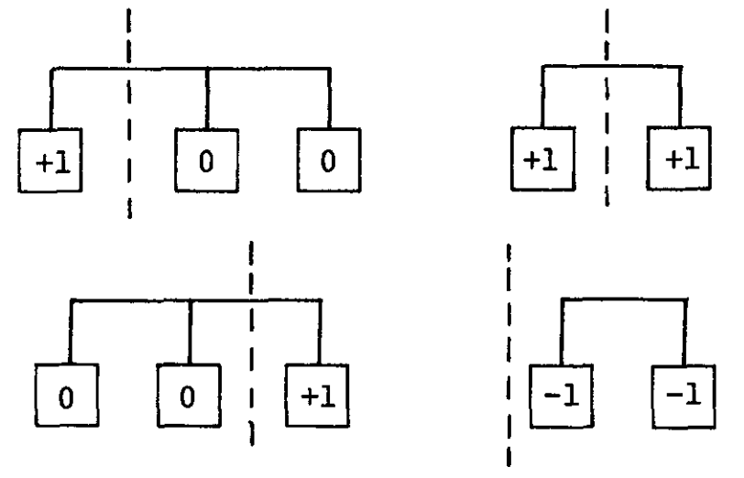
Fiduccia-Mattheyses (FM) Algorithm
Fiduccia and Mattheyses, “A linear time heuristic for improving network partitions,” ACM Design Automation Conference (DAC), 1982
Cell gains based on “net”
Notes:
To overcome these drawbacks, Fiduccia and Mat came up with an algorithm in design automation conference 1982, a linear time heuristic for improving network partitions. This is an algorithm that directly targets circuit graph or hypergraph.
Let’s take a look at a few examples on the difference between partitioning a typical graph and a hypergraph. Here I have three examples. Each square represents a gate and each line connects to several gates. On the example here, we have the typical graph and there is no hyperedge. You know, each edge connects to at most two squares or two gates. The numbers on each square shows the gain value, the value it will decrease the cut size by moving that square to the other side. For example, (explain …)
Now, what if we have a hyper edge, an edge that connects to more than two gates, like the example here. I have an edge, an hyper edge connecting to three squares. (explain …)
Now you see the difference. For hypergraph partitioning, the gain value should be calculated based on the number of connected nets. Once we understand this, everything is pretty much the same!

Slide 6
Hypergraph Partition Problem Formulation
Input: A hypergraph with
Set vertices V. (|V| = n)
Set of hyperedges E (total # pins in netlist = p)
Area a_{u} for each vertex u in V
Cost c_{e} for each hyperedge in e
An area ratio r
Output: two partitions X & Y such that
Total cost of hyperedges cut is minimized
area(X) / (area(X) + area(Y)) is about r
This problem has been proven to be NP-complete
Notes:
Let’s formally define the hypergraph partition problem. Now we are approaching a more realistic problem that doesn’t just consider the cut size as KL algorithm does, but we also take the area constraint into account. So, the input (explain …)

Slide 7
Ideas of FM Algorithm
Similar to KL:
Work in passes
Lock vertices after moved
Only move those vertices up to the maximum partial sum of gain
Difference from KL:
Not exchanging pairs of vertices
Move only one vertex at each time
Calculate the gain value based on connected nets
The use of gain bucket data structure
Notes:
With this formulation, the idea of FM algorithm is very similar to KL. (explain…)

Slide 8
FM Partitioning Algorithm
Moves are made based on object gain
Object Gain: The amount of change in cut crossings that will occur if an object is moved from its current partition into the other partition
A pass description
While there is unlocked object
1. Each object is assigned a gain
2. Objects are put into a sorted gain list
3. The object with the highest gain from the larger of the two sides is selected and moved
4. The moved object is "locked"
5. Gains of "touched" objects are recomputed
6. Gain lists are resorted
Repeat the pass until there is no improvement
Notes:
This slide shows the pseudocode of FM partition algorithm. In general, FM algorithm behaves in a similar way to KL algorithm. IT moves gate based on object gain, and the gain is defined as the amount of … (explain)

Slide 9
FM Algorithm Walkthrough – 1
Let’s focus on 2-pin net first for simplicity
(degenerate to KL)
-1
0
2
0
-1
0
-2
0
0
-2
-1
1
-1
1
Notes:
Let’s take a walkthrough for the FM algorithm. For simplicity, this walkthrough is going to just focus on two-pin net. You know, each net connects to exactly only two gates, and that degenerates to KL algorithm. But, the procedure of FM is slightly different in terms of swapping gates. Let’s take a look.
(explain…)

Slide 10
FM Algorithm Walkthrough – 2
-1
0
2
0
-1
0
-2
0
0
-2
-1
1
-1
1

Slide 11
FM Algorithm Walkthrough – 3
-1
-2
-2
-2
0
-1
-2
0
0
-2
-1
1
-1
1

Slide 12
FM Algorithm Walkthrough – 4
-1
-2
-2
-2
0
-1
-2
0
0
-2
-1
1
1
-1

Slide 13
FM Algorithm Walkthrough – 5
-1
-2
-2
-2
0
-1
-2
0
0
-2
-1
1
1
-1

Slide 14
FM Algorithm Walkthrough – 6
-1
-2
-2
-2
0
-1
-2
0
-2
-2
1
-1
-1
-1

Slide 15
FM Algorithm Walkthrough – 7
-1
-2
-2
-2
0
-1
-2
0
-2
-2
1
-1
-1
-1

Slide 16
FM Algorithm Walkthrough – 8
-1
-2
-2
-2
-1
-2
0
0
-2
-2
1
-1
-1
-1

Slide 17
FM Algorithm Walkthrough – 9
-1
-2
-2
-2
1
-2
0
-2
-2
-2
1
-1
-1
-1

Slide 18
FM Algorithm Walkthrough – 10
-1
-2
-2
-2
1
-2
0
-2
-2
1
-2
-1
-1
-1

Slide 19
FM Algorithm Walkthrough – 11
-1
-2
-2
-2
1
-2
0
-2
-2
1
-2
-1
-1
-1

Slide 20
FM Algorithm Walkthrough – 12
-1
-2
-2
-2
1
-2
0
-2
-1
-2
-2
-3
-1
-1

Slide 21
FM Algorithm Walkthrough – 13
-1
-2
-2
-2
1
-2
0
-2
-1
-2
-2
-3
-1
-1

Slide 22
FM Algorithm Walkthrough – 14
-1
-2
-2
1
-2
-2
0
-2
-1
-2
-2
-3
-1
-1

Slide 23
FM Algorithm Walkthrough – 15
-1
-2
-2
-1
-2
-2
-2
-2
-1
-2
-2
-3
-1
-1
Notes:
Finally, we end up with a perfect partition with no cut! Of course, this is a specially designed circuit graph to produce such a perfect result.

Slide 24
Implementation Details
Gain Δg(c) for cell c
Δg(c) = FS(c) – TE(c) ,
where the “moving force“ FS(c) is the number of nets connected to c but not connected to any other cells within c’s partition, i.e., cut nets that connect only to c, and
the “retention force“ TE(c) is the number of uncut nets connected to c.
The higher the gain Δg(c), the higher is the priority to move the cell c to the other partition.
Netlist: a {1, 2}, b {1, 2, 3}, c {1, 4}, d {1, 5}, e {3, 4}
3
2
b
e
a
4
c
1
d
5
Notes:
Now, let’s dive into the implementation details of FM partitioning algorithm using this simple example. Here I have a circuit graph, a hypergraph, of five nodes and five nets. Nodes, 1, 2, 3, 4, 5 and nets a, b, c, d, e. Net a connects to two nodes, 1 and 2, … (explain)
We are going to use this example to go through how FM partitioning algorithm really works. First, we define the gain value for each cell, represented in the function delta g c. Its value is defined as FS c minus TE c. (explain …)

Slide 25
Implementation Details (cont’d)
Gain Δg(c) for cell c
Δg(c) = FS(c) – TE(c) ,
where the “moving force“ FS(c) is the number of nets connected to c but not connected to any other cells within c’s partition, i.e., cut nets that connect only to c, and
the “retention force“ TE(c) is the number of uncut nets connected to c.
Netlist: a {1, 2}, b {1, 2, 3}, c {1, 4}, d {1, 5}, e {3, 4}
2
3
b
e
a
4
c
1
d
5
2
3
Cell 1: FS(1) = 2 TE(1) = 1 Δg(1) = 1
Cell 2: FS(2) = 0 TE(2) = 1 Δg(2) = -1
Cell 3: FS(3) = 1 TE(3) = 1 Δg(3) = 0
Cell 4: FS(4) = 1 TE(4) = 1 Δg(4) = 0
Cell 5: FS(5) = 1 TE(5) = 0 Δg(5) = 1
b
e
a
4
c
1
d
5
Notes:
Based on these notations, we can come up with a table of the FS value, TE value, and gain value for each cell, and then we can select the cell with the highest gain value to move. This is the greedy strategy we have been talking about.
In this table, we can see the FS value, TE value, and gain value for cell 1 are 2, 1, 1, respectively. Looking at this cell, cell 1, what FS value tells you is the number of nets connected to Cell 1 but not connected to any other cells in cell 1’s partition. Or simply put, it’s the cut nets that connect to only cell 1. (explain)

Slide 26
Maximum Positive Gain
Find the maximum positive gain G_{m} for each pass
The maximum positive gain G_{m} is the cumulative cell gain of m moves that produce a minimum cut cost.
G_{m} is determined by the maximum sum of cell gains Δg over a prefix of m moves in a pass
Notes:
With the gain value defined for each cell, at each pass, we will iteratively and greedily select on cell to move to the other side. If you have n cells, then we will move n times. Each move gives us a gain value This process results in a sequence of n numbers as a summation of gain values from the beginning.
But we are not going to move all of them because we may end up with negative value that increases the cut size. So, we will find the maximum positive gain Gm for each pass that is the subsequence giving you the maximum summation of gain values, starting from the first move.
(Explain the second item)

Slide 27
Area Ratio Factor
The ratio factor is the relative balance between the two partitions with respect to cell area – it is used to prevent all cells from clustering into one partition
A common ratio factor r is defined as
where area(A) and area(B) are the total respective areas of partition A and partition B
Notes:
More importantly, we need to take the area constraint into account. We want each partition to be highly balanced or roughly have equal size. To reach this goal, we define a ratio factor as the relative balance between the two partitions with respect to cell area. (explain …)
There are many ways to define the ratio factor to balance partitions but a very common definition is (explain ..)

Slide 28
Balanced Partition
The balance criterion enforces the ratio factor
To ensure feasibility, the maximum cell area area_{max}(V) must be taken into account
A partitioning of V into two partitions A and B is said to be balanced if
[ r ∙ area(V) – area_{max}(V) ] ≤ area(A) ≤ [ r ∙ area(V) + area_{max}(V) ]
Notes:
With the given ratio factor, we can define a balance criteria to enforce balanced partition. A partitioning of V into two partitions A and B is said to be balanced if …

Slide 29
Base Cell
A base cell is a cell c that has the greatest cell gain Δg(c) among all free cells, and whose move does not violate the balance criterion
Base cell
Cell 1: FS(1) = 2 TE(1) = 1 Δg(1) = 1
Cell 2: FS(2) = 0 TE(2) = 1 Δg(2) = -1
Cell 3: FS(3) = 1 TE(3) = 1 Δg(3) = 0
Cell 4: FS(4) = 1 TE(4) = 1 Δg(4) = 0
Notes:
The final definition is the base cell. This is simple, a base cell is … (explain …)
Essentially, this is the cell that we will be moving from one side to another, and be locked after the movement. For example, looking at this table we just came up with, we have the gain values for cells 1, 2, 3, 4, as 1, -1, 0, and 0. (explain …)

Slide 30
FM Algorithm (One Pass)
A
2
3
B
Given: Ratio factor r = 0.375
area(Cell_1) = 2 area(Cell_2) = 4 area(Cell_3) = 1 area(Cell_4) = 4 area(Cell_5) = 5
b
e
a
4
c
d
1
5
Step 0: Compute the balance criterion
[ r ∙ area(V) – area_{max}(V) ] ≤ area(A) ≤ [ r ∙ area(V) + area_{max}(V) ]
0.375 * 16 – 5 = 1 ≤ area(A) ≤ 11 = 0.375 * 16 +5.
Notes:
Based on all these definitions and notations, let’s take a look at how one pass does in FM algorithm. Supposed we have the same graph as the previous slide, the ratio factor is given as 0.375, and I have the area for cell 1 be 2, area for cell 2 be 5, area for cell 3 be 1, area for cell 4 be 4, and area for cell 5 be 5.
The balance criteria is not going to change because we are not modifying the circuit itself but coming up with a partition for all these cells. So, the first step is to compute the balance criterion. (explain …)

Slide 31
FM Algorithm (One Pass)
FS(c): # cut nets that connect only to c TE(c): # uncut nets connected to c
A
2
3
B
b
e
a
4
c
d
1
5
Step 1: Compute the gains of each cell Cell 1: FS(Cell_1) = 2 TE(Cell_1) = 1 Δg(Cell_1) = 1
Cell 2: FS(Cell_2) = 0 TE(Cell_2) = 1 Δg(Cell_2) = -1
Cell 3: FS(Cell_3) = 1 TE(Cell_3) = 1 Δg(Cell_3) = 0
Cell 4: FS(Cell_4) = 1 TE(Cell_4) = 1 Δg(Cell_4) = 0
Cell 5: FS(Cell_5) = 1 TE(Cell_5) = 0 Δg(Cell_5) = 1
Notes:
The next step is to compute the gain value for each cell. That is, we compute the table of FS value, TE value, and use FS minus TS to derive the gain value for each cell. Again, FS value is ... (explain)

Slide 32
FM Algorithm (One Pass)
Cell 1: FS(Cell_1) = 2 TE(Cell_1) = 1 Δg(Cell_1) = 1
Cell 2: FS(Cell_2) = 0 TE(Cell_2) = 1 Δg(Cell_2) = -1
Cell 3: FS(Cell_3) = 1 TE(Cell_3) = 1 Δg(Cell_3) = 0
Cell 4: FS(Cell_4) = 1 TE(Cell_4) = 1 Δg(Cell_4) = 0
Cell 5: FS(Cell_5) = 1 TE(Cell_5) = 0 Δg(Cell_5) = 1
A
2
3
B
b
e
a
4
c
d
Ratio factor r = 0.375
area(Cell_1) = 2 area(Cell_2) = 4 area(Cell_3) = 1 area(Cell_4) = 4 area(Cell_5) = 5
1
5
Step 2: Select the base cell
Possible base cells are Cell 1 and Cell 5
Balance criterion after moving Cell 1: area(A) = area(Cell_2) = 4
Balance criterion after moving Cell 5: area(A) = area(Cell_1) + area(Cell_2) + area(Cell_5) = 11
Both moves respect the balance criterion. Let’s select Cell 1 (can also do Cell 5).
1 ≤ area(A) ≤ 11
Notes:
Once we have the table up to date, the next step is to select the base cell. The definition of base cell is the cell that has the maximum gain value in the current iteration and will be the candidate for moving to the other side. Why am I saying candidate? Well, we have area constraint, right? We need to make sure this candidate is a valid candidate such that moving it to the other side doesn't violate the balance criteria constrain.
For instance (...)

Slide 33
FM Algorithm (One Pass)
FS(c): # cut nets that connect only to c TE(c): # uncut nets connected to c
A
2
3
B
b
e
a
4
c
d
1
5
Step 3: Fix base cell, update Δg values
Cell 2: FS(Cell_2) = 2 TE(Cell_2) = 0 Δg(Cell_2) = 2
Cell 3: FS(Cell_3) = 0 TE(Cell_3) = 1 Δg(Cell_3) = -1
Cell 4: FS(Cell_4) = 0 TE(Cell_4) = 2 Δg(Cell_4) = -2
Cell 5: FS(Cell_5) = 0 TE(Cell_5) = 1 Δg(Cell_5) = -1
After Iteration i = 1: Partition A₁ = {2}, Partition B₁ = {1,3,4,5}, with fixed cell {1}.

Slide 34
FM Algorithm (One Pass)
A
2
3
B
Lock Cell 1
b
e
Cell 2: FS(Cell_2) = 2 TE(Cell_2) = 0 Δg(Cell_2) = 2
Cell 3: FS(Cell_3) = 0 TE(Cell_3) = 1 Δg(Cell_3) = -1
Cell 4: FS(Cell_4) = 0 TE(Cell_4) = 2 Δg(Cell_4) = -2
Cell 5: FS(Cell_5) = 0 TE(Cell_5) = 1 Δg(Cell_5) = -1
a
4
c
d
1
5
Next iteration …
Cell 2 has maximum gain Δg₂ = 2, area(A) = 0, balance criterion ( ) is violated
Cell 3 has next maximum gain Δg₂ = -1, area(A) = 5, balance criterion is met
Cell 5 has next maximum gain Δg₂= -1, area(A) = 9, balance criterion is met
Move cell 3, updated partitions: A₂ = {2,3}, B₂ = {1,4,5}, with fixed cells {1,3}
1 ≤ area(A) ≤ 11
Notes:
With the new table of gain value, the next iteration needs to select one cell to move. (explain …)

Slide 35
FM Algorithm (One Pass)
A
2
3
Lock Cell 1 and Cell 3
e
Cell 2: Δg(Cell_2) = 1
Cell 4: Δg(Cell_4) = 0
Cell 5: Δg(Cell_5) = -1
a
b
B
4
c
d
1
5
Next iteration …
Cell 2 has maximum gain Δg₃ = 1, area(A) = 1, balance criterion is met. Move cell 2, updated partitions: A₃ = {3}, B₃ = {1,2,4,5}, with fixed cells {1,2,3}

Slide 36
FM Algorithm (One Pass)
B
2
3
A
Lock Cell 1, Cell 3, and Cell 2
e
a
b
4
Cell 4: Δg(Cell_4) = 0
Cell 5: Δg(Cell_5) = -1
c
d
1
5
Next iteration …
Cell 4 has maximum gain Δg₄ = 0, area(A) = 5, balance criterion is met. Move cell 4, updated partitions: A₄ = {3,4}, B₃ = {1,2,5}, with fixed cells {1,2,3,4}

Slide 37
FM Algorithm (One Pass)
B
2
3
A
Lock Cell 1, Cell 3, Cell 2, and Cell 4
e
a
b
4
Cell 5: Δg(Cell_5) = -1
c
d
1
5
Next iteration …
Cell 5 has maximum gain Δg₅ = -1, area(A) = 10, balance criterion is met. Move cell 5, updated partitions: A₄ = {3,4,5}, B₃ = {1,2}, all cells {1,2,3,4,5} fixed.

Slide 38
FM Algorithm (One Pass)
Ratio factor r = 0.375
area(Cell_1) = 2 area(Cell_2) = 4 area(Cell_3) = 1 area(Cell_4) = 4 area(Cell_5) = 5
B
2
3
A
End of each pass: find best move sequence c₁ … c_{m}
G₁ = Δg₁ = 1 G₂ = Δg₁ + Δg₂ = 0 G₃ = Δg₁ + Δg₂ + Δg₃ = 1 G₄ = Δg₁ + Δg₂ + Δg₃ + Δg₄ = 1 G₅ = Δg₁ + Δg₂ + Δg₃ + Δg₄ + Δg₅ = 0.
e
a
b
4
c
d
1
5
found in iterations 1, 3 and 4.
The move prefix m = 4 is selected due to the better balance ratio (area(A) = 5); the four cells 1, 2, 3 and 4 are then moved.
Maximum positive cumulative gain

Slide 39
FM Algorithm (One Pass)
Ratio factor r = 0.375
area(Cell_1) = 2 area(Cell_2) = 4 area(Cell_3) = 1 area(Cell_4) = 4 area(Cell_5) = 5
B
2
3
A
End of each pass: find best move sequence c₁ … c_{m}
G₁ = Δg₁ = 1 G₂ = Δg₁ + Δg₂ = 0 G₃ = Δg₁ + Δg₂ + Δg₃ = 1 G₄ = Δg₁ + Δg₂ + Δg₃ + Δg₄ = 1 (more balanced) G₅ = Δg₁ + Δg₂ + Δg₃ + Δg₄ + Δg₅ = 0.
e
a
b
4
c
d
1
5
found in iterations 1, 3 and 4.
The move prefix m = 4 is selected due to the better balance ratio (area(A) = 5); the four cells 1, 2, 3 and 4 are then moved.
Result of Pass 1: Current partitions: A = {3,4}, B = {1,2,5}, cut cost reduced from 3 to 2.
Maximum positive cumulative gain

Slide 40
Gain-based Bucket Data Structure
+pmax
Max
Gain
Cell
#
Cell
#
-pmax
1
2
n

Slide 41
Incremental Update
Which gain values need update after moving Cell 3?
A
2
3
B
A
2
3
b
e
e
a
a
b
B
4
4
c
c
d
d
1
5
1
5

Slide 42
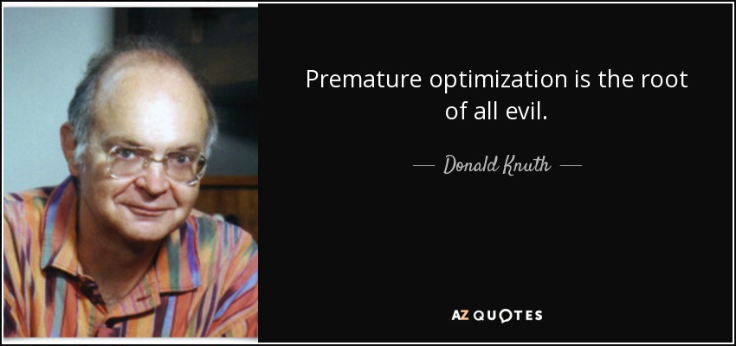

Slide 43
Time Complexity of FM Algorithm
For each pass
Constant time to find the best vertex to move
After each move, time to update gain buckets is proportional to degree of vertex moved
Total time is O(p), where p is total number of pins
Number of passes is usually small
Gain values converge very quickly

Slide 44
Programming Assignment #1
Implement FM partitioning algorithm
https://github.com/tsung-wei-huang/ece5960-physical-design/tree/main/PA1
Two checkpoint dues, 9/7 and 9/14 23:59 PM
https://github.com/tsung-wei-huang/ece5960-physical-design/issues/2
Final Due on 9/21 (Wed) 23:59 PM
Upload your solutions to twhuang-server-01.ece.utah.edu
Account: ece6960-fall22
Place your source code + README under PA1/your_uid/
README should contain instruction to compile & run your code

Slide 45
Programming Assignment #1 (cont’d)
In addition to source code + README, upload a report with:
A table showing your results of each benchmark
A section discussing what challenges you encounter
A section discussing how you overcome those challenges
Also discuss unsolved challenges
The report needs to be just a one- or two-page pdf
No need to be lengthy …
Upload your report to the class GitHub page
https://github.com/tsung-wei-huang/ece5960-physical-design/issues/1
Due 9/21 23:59 PM

Slide 46
In-class Presentation: 9/14
Circuit partition research presentation on 9/14 (in class)
George Karypis and Vipin Kumar, "Multilevel k-way Hypergraph Partitioning," 1999 ACM/IEEE Design Automation Conference (DAC)
Honghua Yang and Martin Wong, "Efficient Network Flow Based Min-Cut Balanced Partitioning," 1994 ACM/IEEE International Conference on Computer-aided Design (ICCAD)
Masahiro Tanaka, Kenjiro Taura, Toshihiro Hanawa, Kentaro Torisawa, "Automatic Graph Partitioning for Very Large-scale Deep Learning," 2021 IEEE International Parallel and Distributed Processing Symposium (IPDPS 2021)
Upload your pptx to https://github.com/tsung-wei-huang/ece5960-physical-design/issues/9 before presentation

Slide 47
Summary
We have discussed FM partitioning algorithm
Inherited greedy movement ideas from KL algorithm
Extended to hypergraph
Incorporated area constraint (balanced partition)
We have discussed implementation details of FM algorithm
Bucket list data structure to keep track of gains and cells
Incremental update for gain values
We have released the first programming assignment
We have released the first in-class research presentation

